Slide 1

‘ASMR’ group PRESENTS
Literature Review
On load forecasting using
ML & deep learning techniques

Slide 2

outline
outline
1.
A review on ARIMA – a machine learning model that provides means of forecasting time series data.
Financial Time Series Forecasting with the Deep Learning
Ensemble Model – a quick review!
“
2.
”
Stacking Ensemble Methodology Using Deep Learning and ARIMA Models for Short-Term Load Forecasting – a quick review!
“
3.
”

Slide 3


Arima model
Auto Regressive(AR) Integrated(I) Moving Average(MA)
$$X_{t}$$
$$μ$$
$$X_{i−1}$$
$$ε_{t−1 }$$
$$Φ_{i}$$
$$Θ_{j}$$
= Actual Observation
= Vertical Translation
= Past time series
= Error in prediction on previous data points
= ARMA coefficient
= ARMA coefficient
$$X_{t}=μ +ε_{t}+\sum_{i=1}^{p}{Φ_{i}X_{i−1}}+\sum_{j=1}^{q}{Θ_{j}ε_{t−1 } }$$
AR Part
MA Part

Slide 4




Arima model
Auto Regressive(AR) Integrated(I) Moving Average(MA)
ARIMA(P,D,Q)
$$X_{t}=μ +ε_{t}+\sum_{i=1}^{p}{Φ_{i}X_{i−1}}+\sum_{j=1}^{q}{Θ_{j}ε_{t−1 } }$$
P = Order of the AR model
D = # of Differencing
Q = Order of the MA model
$$X_{i}=X_{i}−X_{i+1}$$
Differencing
$$X=\left[5,4,6,7,9,12\right]$$
AR Part
MA Part
$$X^{∗}=\left[1,−2,−1,−2,−3\right]$$
$$X^{∗∗}=\left[3,−1,1,1\right]$$
Special Case: ARIMA(P,0,Q)=ARMA(P,Q)

Slide 5
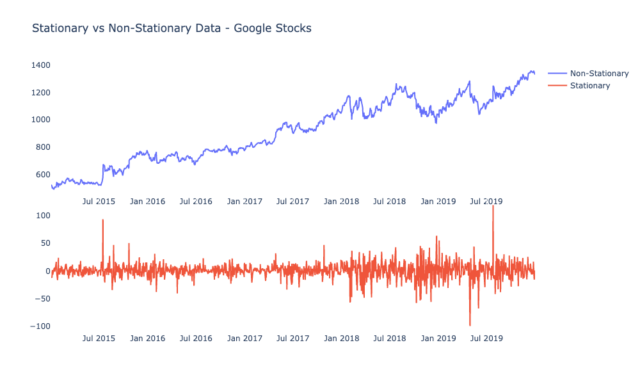
Arima model
Auto Regressive(AR) Integrated(I) Moving Average(MA)
ARIMA requires dataset to be stationary.
Stationary data = mean & variance is constant for whole series in any time period chosen

Slide 6
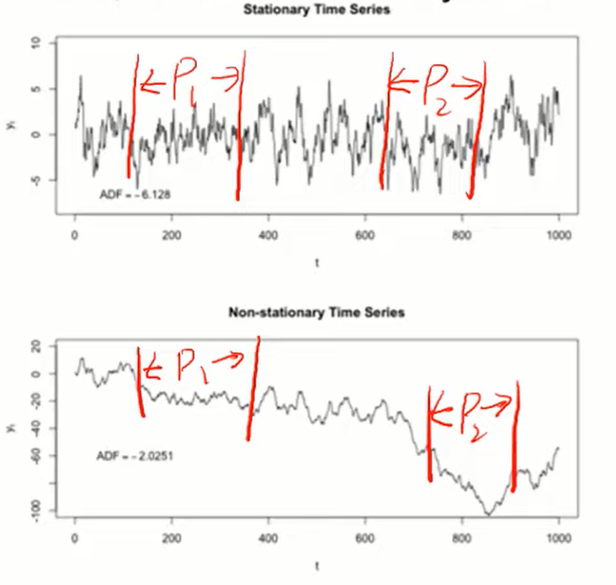
Arima model
ARIMA requires dataset to be stationary.
Stationary data = mean & variance is constant for whole series in any time period chosen

Slide 7
Paper 1
“
Financial Time Series Forecasting with the Deep Learning
Ensemble Model
”

Slide 8


Unique Contribution
1.
proposal of ARMA-CNNLSTM Hybrid Model
Combination of ARMA and Deep learning techniques: CNN + LSTM
Evaluation & validation of approach
2.
Evaluation & Validation of proposed approach using Shanghai Stock Exchange Data
and Hang Seng Index Data

Slide 9
Dataset Description
Dataset
Introduction
# Rows
Preprocessing
On Dataset
EU ETS
+
Shanghai Composite Index
+
Bitcoin dataset
Total of
645 + 2447 + 3107
Observations from various timeframes from three datasets.
Only Shanghai Index was stationary, rest of them was non-stationary. So, Shanghai Index was differenced once.

Slide 10
Methodology
1. Collect data
2. Preprocess data
3. Train-validation Split 80:20
5. Find the Average of ARMA & CNN-LSTM output
4. Train ARMA AND CNN-LSTM
6. Find the total forecast (weighted sum)
8. Evaluate performance
NO
10. END
9. Satisfactory
Results?
10. Adjust hyperparameters
NO
YES

Slide 11
Models used
ARMA-CNNLSTM
Others (compared to)
ARMA
+
CNN
+
LSTM
Random Walk, ARMA, MLP, LSTM, CNN, ARMA-CNNLSTM

Slide 12
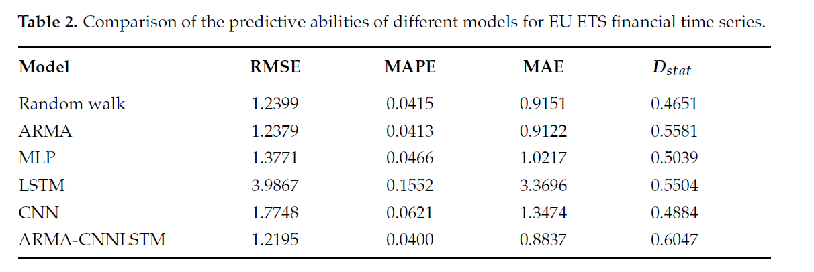
Results
RMSE = Root Mean Squared Error
MAPE = Mean Absolute Percentage Error
MAE = Mean Absolute Error
Dstat = Directional prediction statistics

Slide 13
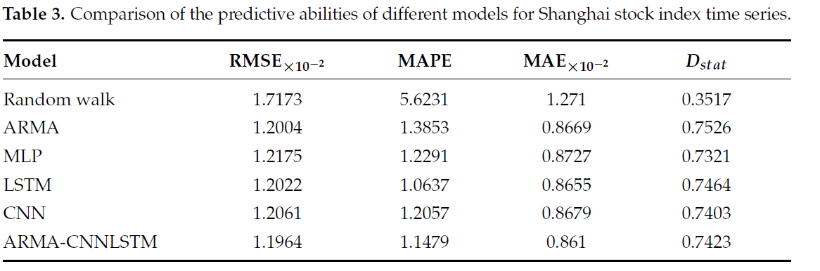
Results
RMSE = Root Mean Squared Error
MAPE = Mean Absolute Percentage Error
MAE = Mean Absolute Error
Dstat = Directional prediction statistics

Slide 14
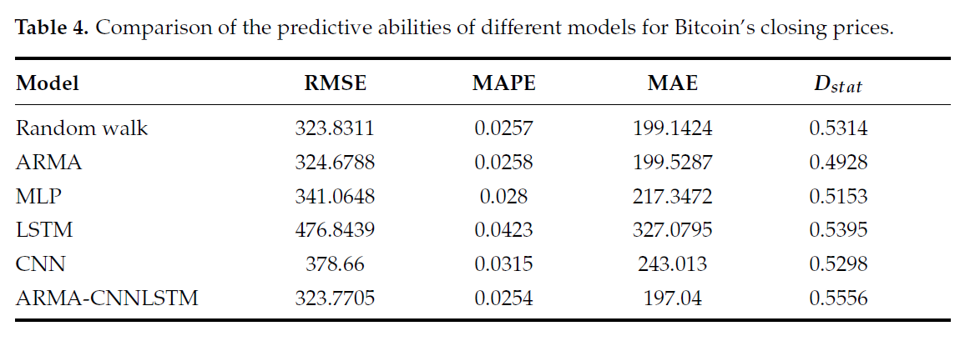
Results
RMSE = Root Mean Squared Error
MAPE = Mean Absolute Percentage Error
MAE = Mean Absolute Error
Dstat = Directional prediction statistics

Slide 15
Paper 2
“
Stacking Ensemble Methodology Using Deep Learning and ARIMA Models for Short-Term Load Forecasting
”

Slide 16

Unique Contribution
1.
proposal of stacking ensemble Model
Stacking of different ARIMA model pools!
deep feedforward neural network(DFNN)!
2.
Proposal of Diff. performance function.
Different endogenous and exogenous input variables!
Proposing a modified performance function & early stop mechanism!
3.
Evaluation of the proposed method
Evaluation & Validation of the stacking ensemble model on New England case study!
Achieved 10%-25% error improvement on that case study.

Slide 17
Dataset Description
Dataset
Introduction
Problem type
And # Rows
Preprocessing
On Dataset
NEW ENGLAND Case Study Dataset!
Observation from
2004-2016
Contains hourly electricity demand data for forecasting.
131,496 hourly demand observations!
Preprocessing completed to remove outliers and seasonal effects, then split into train-test.

Slide 18
Methodology
1. Collect load data
2. Preprocess data
3. Train-validation Split
4. Select & fit Arima forecasters
6. Train Deep Feedforward neural network(DFNN)
Using Arima forecasters outputs
& exogenous variables
5. Extract relevant exogenous variables
7. Implement early stop mechanism & modified performance function
8. Evaluate performance
10. Adjust hyperparameters
9. Satisfactory
Results?
10. end
ON
YES

Slide 19
Models used
Arima
DFNN
Box Jenkins
Autoregressive Integrated Moving Average
Used to map the linear components of the time series
Deep Feedforward Neural Network
Used to map the non-linear components of the time series
Used to select relevant exogenougs variables
Used to extract hard non-linear components

Slide 20
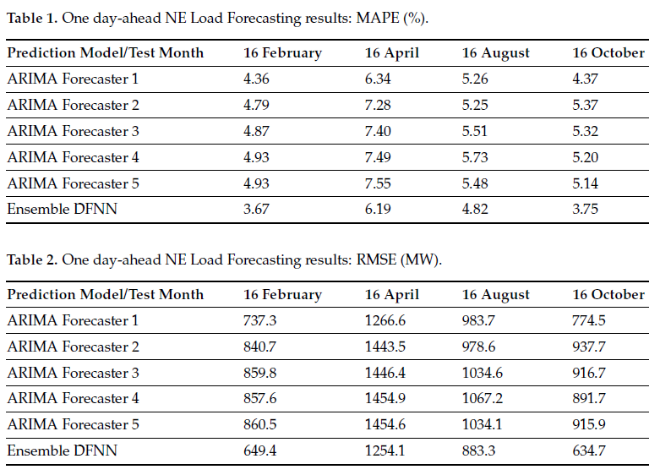
Results
Parameters:
Mean Absolute percentage error(MAPE)
Root mean squared error (RMSE)
BEST
BEST

Slide 21

Future Work
Future work
Extend diversity of the input forecasters, training on other time-series data & models.
1.
Use alternative cost functions to address the error bias.
2.
Study different combinations of dissimilar methos: ensemble models, regression techniques.
3.
4.
Increase the number of training windows and it range, to gauge long-term trends with forecasting models.

Slide 22

THANK YOU
Shaiara Tabassum | Mosroor Mofiz Arman | Md Sahadul Hasan Arian

Slide 23
references
Paper 1
Paper 2
Paper 3
He, K.; Yang, Q.; Ji, L.; Pan, J.; Zou, Y. Financial Time Series Forecasting with the Deep Learning Ensemble Model. Mathematics 2023, 11, 1054. https://doi.org/10.3390/math11041054
Bento PMR, Pombo JAN, Calado MRA, Mariano SJPS. Stacking Ensemble Methodology Using Deep Learning and ARIMA Models for Short-Term Load Forecasting. Energies. 2021; 14(21):7378. https://doi.org/10.3390/en14217378
X. Chen, W. Chen, V. Dinavahi, Y. Liu and J. Feng, "Short-Term Load Forecasting and Associated Weather Variables Prediction Using ResNet-LSTM Based Deep Learning," in IEEE Access, vol. 11, pp. 5393-5405, 2023, https://doi.org/10.1109/ACCESS.2023.3236663

